Slide 1
Cachexia Study: Kumar 2025.1
Muneer G. Hasham, Ph.D., Service Lead, XLIS

Slide 2
Experimental Design
The experiment was designed as per the agreed SOW with the exception of:
The mice were not housed with XLIS after the graft but sent directly to the Envision cages. The reason for this deviation was to allow the Envision system to obtain as much as data possible before the mice succumb to illness.
More mice were obtained from the breeding, therefore the Vehicle group (saline) was increased by 8 mice, to improve the power.

Slide 3
Cage Distribution and the CD2F1 mice origin

Slide 4
Results
The deliverable for this study were(a) 50 male mice: 40 with CT-26 tumors and 10 with Saline (b) excel sheet with mouse IDs, weights, BCS and tumor size (in weights) . The excel sheet is submitted with this report.
In general, it takes two weeks to develop cachexia in these CD2F1 mice. In this study it took three weeks for the cachexia to appear and the mice succumbing to the disease (see Figure on the left). Mice were euthanized as they showed lowered BCS, weight, tumors >2000mm³ or ill health.
Three out of the 40 mice survived to day 30 and did not lose weight, but they had lowered body condition score (see next slide).
Details of the study are within the attached excel sheet.

Slide 5
Body condition Score and Weight Changes

Slide 6
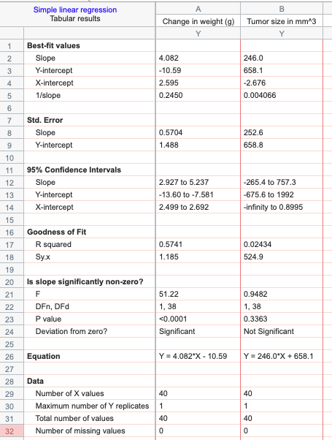
Correlations
There is a significant correlation (P<0.0001) between observed BCS and change in weight (blue dots), but not tumor size (purple triangles) (P=0.3363). This is partly due to metastasis that occurs in mice (see notes in excel sheet)and therefore, the caliper measurements may not reflect the full tumor load.

Slide 7
Conclusions and next steps
The study is complete and the data on Envision has been collected.
Attached with this report is the excel sheet that contains all the details for all the mice
Tumors, that grew as per previous studies (see Figure) and Plasma was collected (at no cost). The plasma can be tested for molecular markers to correlate the BCS and weight changes to a molecular mechanism. A portion of the tumors were frozen, and a portion was fixed in formalin.

